Slide 1


Adarsh Institute of Technology &
Research Centre, Vita
Department of Computer Science & Engineering
Class-TY
Mini project Presentation on:
“Aptitude Quiz Website”
Team members :
1. Mr. Akshay Sarjerao Bandgar(CS3010)
2. Mr. Adarsh Rupesh Jadhav (CS3015)
3.Mr. Rushikesh Pravin Mhetre (CS3016)
4.Mr. Pranav Dilip Surywanshi(CS3017)
Academic Year
2023-2024
Under Guidance of:
Miss.S.L.Jadhav

Slide 2
INDEX
Introduction
Relevance of the Work
Proposed Work
Proposed Methodology
Literature Review
HW/SW Requirement
Flowchart
References

Slide 3
INTRODUCTION
This project aims to create a user-friendly website where users can access a wide range of aptitude quizzes across various categories, such as mathematics, logical reasoning, verbal ability, and more.
The quizzes are designed to challenge and stimulate critical thinking, problem-solving, and analytical skills.

Slide 4
Relevance of the Work:
High Demand:
Many students need study aptitude materials for their placement.
Challenges Finding Materials:
Students often struggle to find the right aptitude questions.
Modern Education:
More college students are learning on aptitude quiz online platforms.
Convenience:
This project makes it easy for students to find what they need for their placement.

Slide 5
Proposed Work:
This platform will offer a wide range of aptitude quizzes designed to help users identify their strengths and weaknesses in various areas, such as mathematics, logical reasoning, verbal ability, and more.
Users will receive personalized feedback based on their quiz results, enabling them to make informed decisions about their education and career paths.

Slide 6
Proposed Methodology:
Our website provide aptitude related questions.
New user can create the account then user will be able to access all aptitude test material.
Then user visit the home page and in that home user can access various option /feature.
user can see 4 option or categories:
1.Mathamatical
2.Logical VerbalS
3.Logical Reasoning
4.Data Interpretion
we provide video links.

Slide 7
Literature Review
Sr.no | Author | Year | Advantages
1. | K.Swasha | 2023 | In 2023 research explored how college notes websites impact academic performance. Students who regularly use college notes websites often achieve better academic results due to access to supplementary learning materials. College notes websites allow students to study at their own pace, catering to individual learning speeds and preference.

Slide 8
Sr.no | Author | Year | Advantages
2. | C.Compana | 2021 | Students can choose notes that align with their learning style, helping them absorb information more effectively. Students can benefit from peer-to-peer learning by sharing their notes and learning from their peers' perspectives and interpretations.
3. | Dony Tontiardo | 2020 | Aptitude become one of major problem to determine the specialization in college, that sometimes make some individual to choose poorly and causing them to choose the wrong specialization that didn't match their aptitude, however the specialization can be observed and determined from early stage using the help of technology
.

Slide 9
HW/SW Requirement:
HARDWARE REQUIREMENT:
RAM : 2GB
Processor - 3.00Megahertz Intel Platinum IV
Space - 1GB HDD(Min)
Hard Disk - 64 GB (Min)
Keyboard - Standard Windows Keyboard
SOFTWARE REQUIREMENT:
Operating System : Windows 7 and above
Front End language : HTML, CSS, JavaScript, Bootstrap
Back-End language : PHP
Database : MySQL

Slide 10
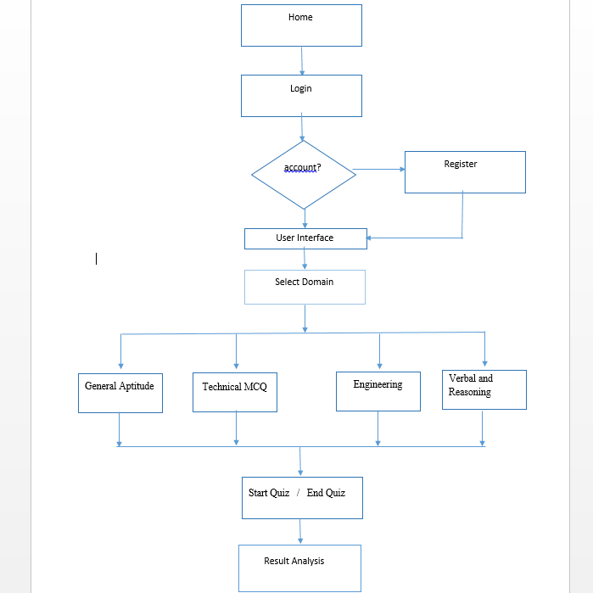
Flowchart :

Slide 11
References
https://ieeexplore.ieee.org/document/10142801
https://www.w3schools.com/
https://www.indiabix.com

Slide 12
THANK YOU

